Slide 1
Curs 11 Introducere in CUDA

Slide 2
Ce este CUDA?
Compute Unified Device Architecture”
o platforma de programare paralela->
Arhitectura care foloseste GPU pt calcul general
permite cresterea performantei
Released by NVIDIA in 2007
Model de programare
Bazat pe extensii C / C++ - pentru a permite ‘heterogeneous programming’
API pt gestionarea device-urilor, a memoriei etc.

Slide 3
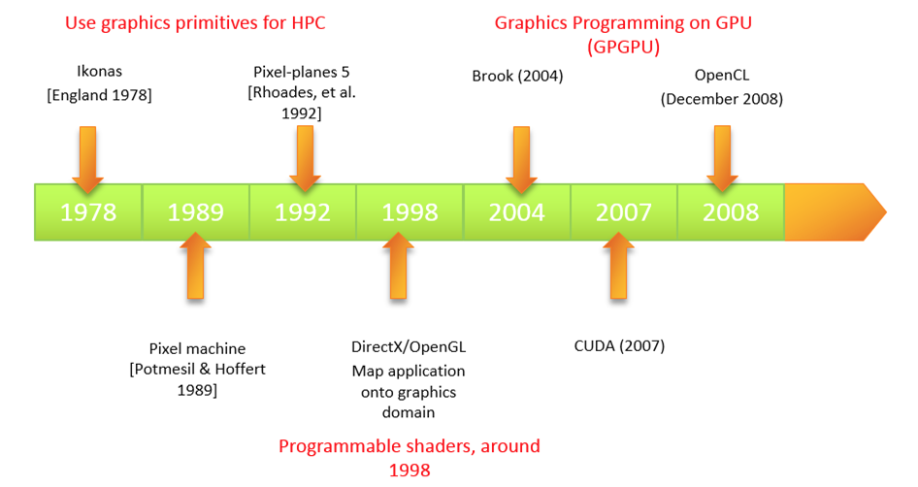
Istoric

Slide 4

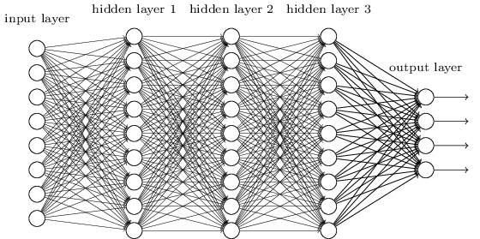

Aplicatii
Bioinformatica
Calcul financiar
Deep learning
Molecular dynamics simulation
Video and audio coding and manipulation
3D imaging and visualization
Consumer game physics
virtual reality products
…

Slide 5
GPGPU
GPU au devenit mai puternice
Mai multa putere de calcul
Memory bandwidth (on chip) ridicata
=> General Purpose GPU (GPGPU)
Sute de mii de core-uri in GPU care ruleaza threaduri in paralel
core-uri mai slabe dar … multe...

Slide 6
CPU vs. GPU
Control
ALU
ALU
ALU
ALU
CPU
GPU
Cache
DRAM
DRAM
© David Kirk/NVIDIA and Wen-mei W. Hwu, 2007-2010
ECE 408, University of Illinois, Urbana-Champaign

Slide 7
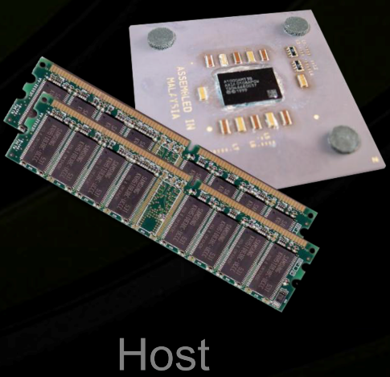
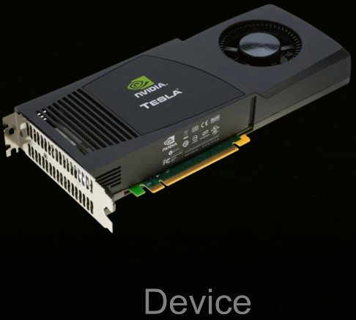
Terminologie
Host: = CPU si memoria asociata
Device: = GPU si memoria asociata
device
Is a coprocessor to the CPU or host
Has its own DRAM (device memory)‏
Runs many threads in parallel
Is typically a GPU but can also be another type of parallel processing device
Diferente intre threadurile GPU si CPU
GPU threads are extremely lightweight
Very little creation overhead
GPU needs 1000s of threads for full efficiency
Multi-core CPU needs only a few

Slide 8
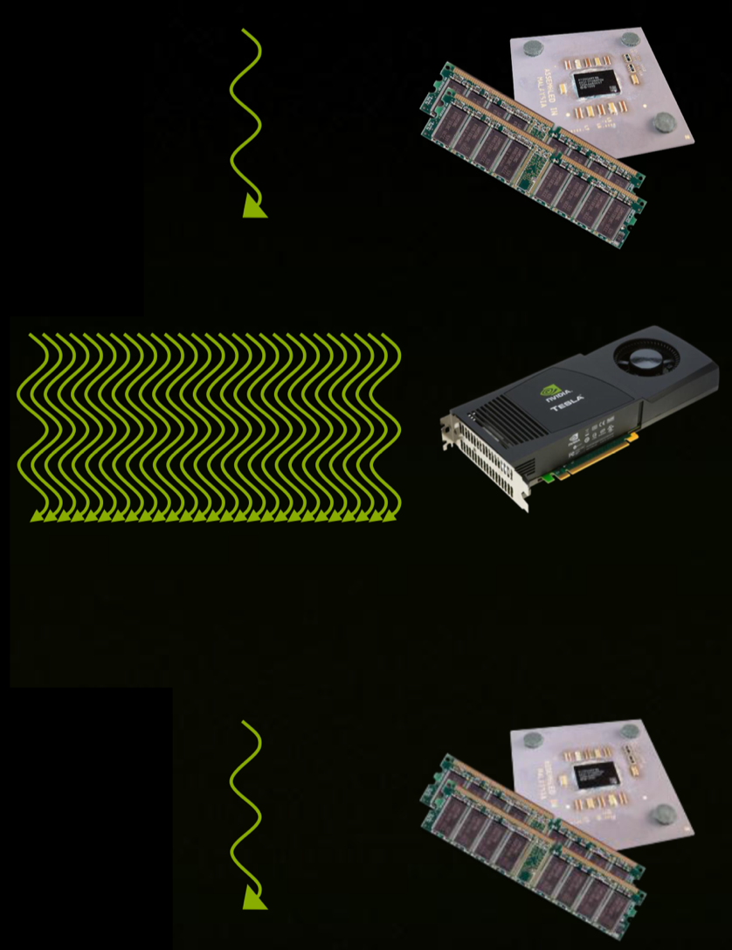
Heterogeneous Computing
Serial Code
Parallel Code
Serial Code

Slide 9
Architecture of a CUDA-capable GPU
Host
streaming multiprocessor
Input Assembler
Thread Execution Manager
Parallel Data Cache
Parallel Data Cache
Parallel Data Cache
Parallel Data Cache
Parallel Data Cache
Parallel Data Cache
Parallel Data Cache
Parallel Data Cache
Texture
Texture
Texture
Texture
Texture
Texture
Texture
Texture
Texture
Load/store
Load/store
Load/store
Load/store
Load/store
Load/store
Global Memory

Slide 10
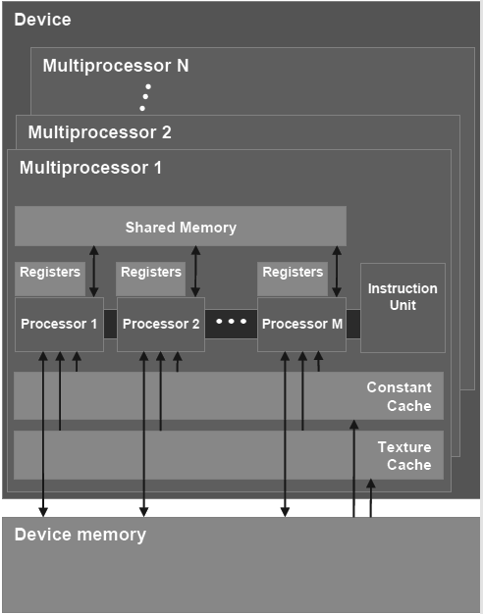
GPU device
Global memory
Streaming Multiprocessors (SM) where each SM has:
Control units
Registers
Execution pipelines
Caches
https://tatourian.com/2013/09/03/nvidia-gpu-architecture-cuda-programming-environment/

Slide 11
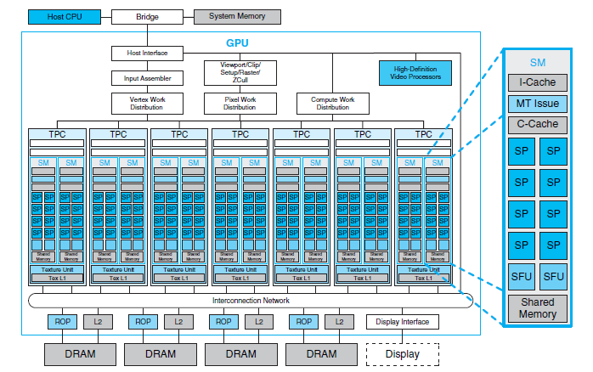
GeForce 8800 Architecture (Tesla)
Streaming MultiProcessor Array

Slide 12
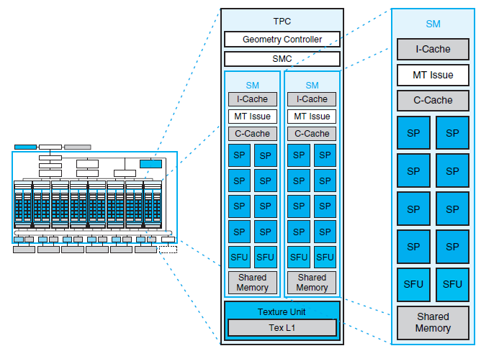
Texture / Processor Cluster
Streaming Multiprocessor
Streaming processor (CUDA core)

Slide 13
Other NVidia architectures
Blackwell Architecture (March 2024)
Hopper Architecture (March 2022)
Ada Lovelace Architecture (September 2022)
Ampere Architecture (2020)
Turing Architecture (2018)
Volta Architecture (2017)
Pascal Architecture (2016)
Maxwell Architecture (2014)
Kepler Architecture (2012)
Fermi Architecture (2010)
Tesla Architecture (2006)
Curie Architecture 2004)
Rankine (2003)
Kelvin (2001)
Celsius (1999)

Slide 14
Hardware Requirement
Cerinte pt GPU
CUDA-capable GPU
Lista device-urilor acceptate: https://developer.nvidia.com/cuda-gpus
Instalare-> documentatie
http://docs.nvidia.com/cuda/

Slide 15
Fluxul de procesare
Se copiaza datele in memoria GPU
Se executa calcul in GPU (mii de threaduri)
Se copiaza datele din memoria GPU in memoria host
Kernel: codul GPU care se va executa

Slide 16
Extended C
Declspecs
global, device, shared, local, constant
Keywords
threadIdx, blockIdx
Intrinsics
__syncthreads
Runtime API
Memory, symbol, execution management
Function launch
__device__ float filter[N];
// a global variable in the GPU, not the CPU.
__global__ void convolve (float *image) {
__shared__ float region[M];
...
region[threadIdx] = image[i];
__syncthreads()
...
image[j] = result;
}
// Allocate GPU memory
void *myimage = cudaMalloc(bytes)
// 100 blocks, 10 threads per block
convolve<<<100, 10>>> (myimage);

Slide 17
CUDA Function Declarations
Executed on the:
Only callable from the:
__device__ float DeviceFunc()
device
device
__global__ void KernelFunc()
device
host
__host__ float HostFunc()
host
host
__global__ defines a kernel function
!!! Must return void
__device__ functions cannot have their address taken

Slide 18
__device__ and __host__
A routine decorated with host instructs the compiler to generate a host-callable entry point (i.e. compile it as host code). Such a routine is host code that can only be called from other host code.
A routine decorated with device instructs the compiler to generate a device-callable entry point (i.e. compile it as device code). Such a routine is device code that can only be called from other device code.
The only situation where device code can be “called from host code” is the kernel launch, which must be decorated with global
A routine with none of the above decorations is treated by nvcc implicitly as if it were decorated with host
You can use both. If you use both, order does not matter. If you use both, the compiler generates both types of routines describe as above, one with a device-callable entry point, and one with a host-callable entry point.
class example
{
public:
float a, b;
__device__ __host__ example(float _a, float _b) : a(_a), b(_b) {};
}

Slide 19
CUDA Function Declarations
For functions executed on the device:
No recursion
No static variable declarations inside the function
No variable number of arguments

Slide 20
Arrays of Parallel Threads
A CUDA kernel is executed by an array of threads
All threads run the same code (SPMD)‏
Each thread has an ID
threadID
0
1
2
3
4
5
6
7
…
float x = input[threadID];
float y = func(x);
output[threadID] = y;
…

Slide 21
Thread Blocks: Scalable Cooperation
Thread-urile dintr-un bloc pot coopera via
shared memory
atomic operations
synchronization barrier
Thread Block 0
Thread Block 1
Thread Block N - 1
threadID
0
1
2
3
4
5
6
7
0
1
2
3
4
5
6
7
0
1
2
3
4
5
6
7
…
float x = input[threadID];
float y = func(x);
output[threadID] = y;
…
…
float x = input[threadID];
float y = func(x);
output[threadID] = y;
…
…
float x = input[threadID];
float y = func(x);
output[threadID] = y;
…
…

Slide 22
Exemplu: Adunare vectori
Parallel code: kernel
__global__ void vectorAdd(double *a, double *b, double *c, int n)
{
// Get our global thread ID
int id = blockIdx.x * blockDim.x + threadIdx.x;
// Make sure not to go out of bounds
if (id < n)
c[id] = a[id] + b[id];
}

Slide 23
Cod: setup
int main( int argc, char* argv[] )
{
// Size of vectors
int n = 1<<20;
size_t no_bytes= n*sizeof(double);
// Host input vectors
double *h_a; double *h_b;
//Host output vector
double *h_c;
// h_a and h_b...[...] … allocation and init
// Device input vectors
double *d_a; double *d_b;
//Device output vector
double *d_c;
// Allocate memory for each vector on GPU
cudaMalloc(&d_a, no_bytes);
cudaMalloc(&d_b, no_bytes);
cudaMalloc(&d_c, no_bytes);
// Copy host vectors to device
cudaMemcpy( d_a, h_a, no_bytes, cudaMemcpyHostToDevice);
cudaMemcpy( d_b, h_b, no_bytes, cudaMemcpyHostToDevice);

Slide 24
Cod: apelare kernel, colectare rezultate
int blockSize, gridSize;
// Number of threads in each thread block
blockSize = 1024;
// Number of thread blocks in grid
gridSize = (int)ceil((float) n / blockSize );
// Execute the kernel
vectorAdd<<<gridSize, blockSize>>>(d_a, d_b, d_c, n);
// Copy array back to host
cudaMemcpy( h_c, d_c, no_bytes, cudaMemcpyDeviceToHost );
// Release device memory
cudaFree(d_a);
cudaFree(d_b);
cudaFree(d_c);
//use h_c [...]
// Release host memory
free(h_a);
free(h_b);
free(h_c);
return 0;
}

Slide 25
><><><><><><><><><
Lansare kernel => executie __global__ function
function <<< >>>
vectorAdd<<<3, 4>>>(d_a, d_b, d_c);
Functia Kernel
Cate blocuri si cate threaduri per bloc
parametrii

Slide 26
Thread, Block, Grid
CUDA foloseste o structura ierahica :
grid
block
thread

Slide 27
Grid
Block 0
Block 1
Block 2
Block
…
thread 0
thread 1
thread 2

Slide 28
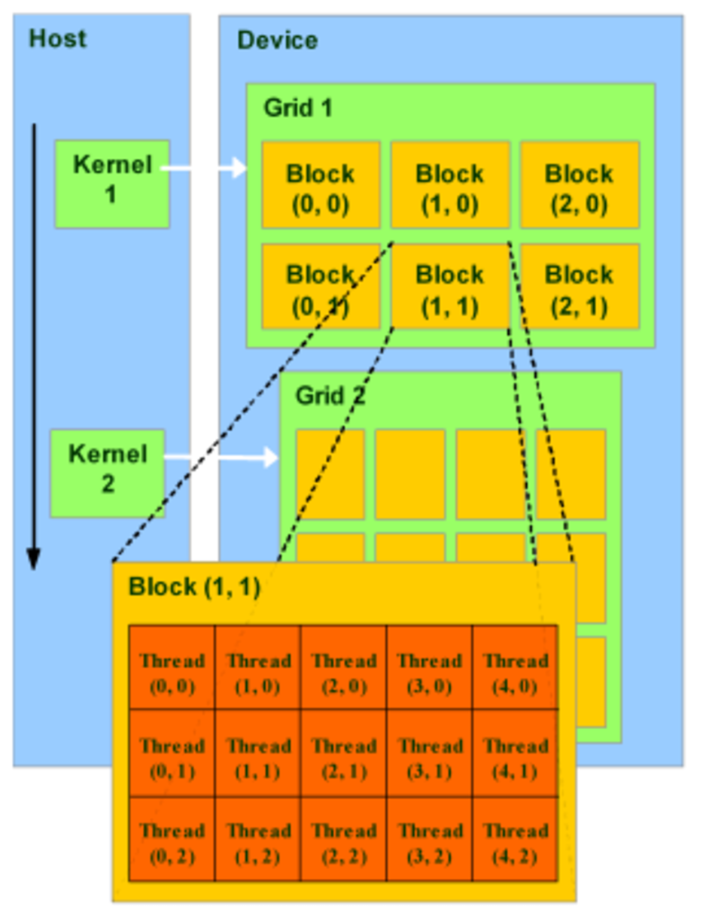
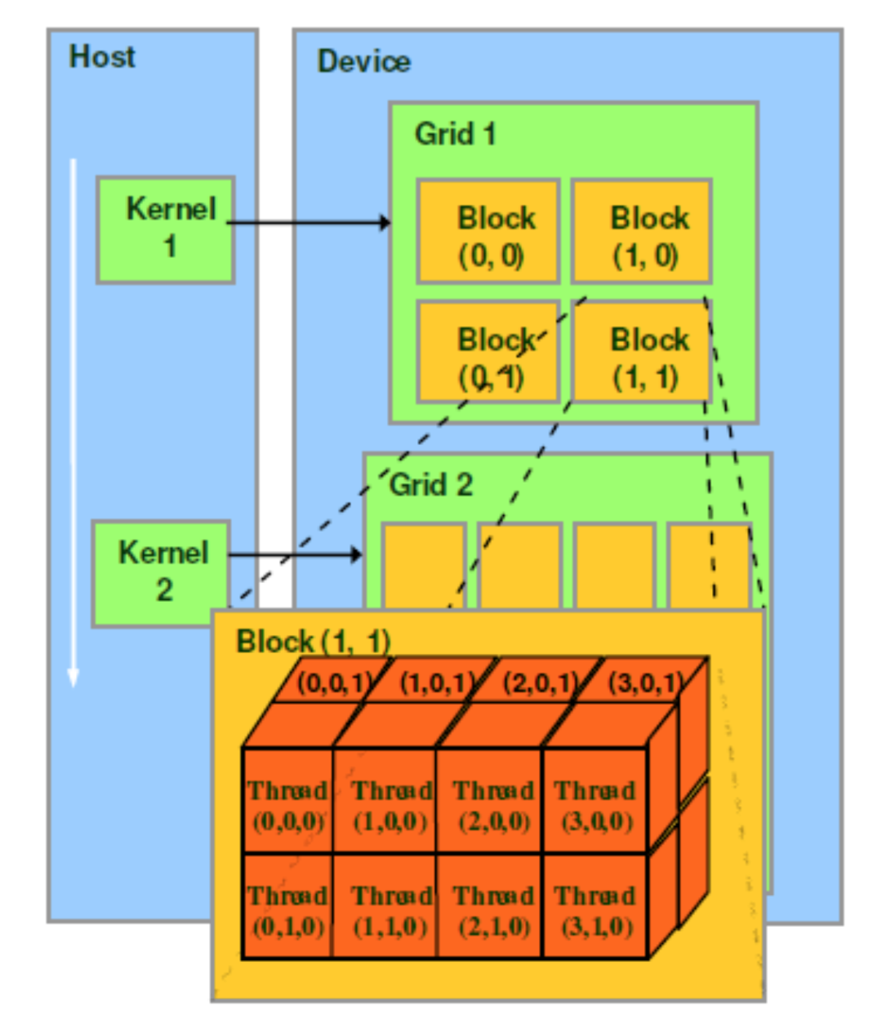
Grid-ul poate sa fie compus din blocuri organizate 1D, 2D sau 3D
Blocurile pot fi compuse din threaduri organizate 1D, 2D sau 3D

Slide 29
<<<blocks per grid, threads per block>>>
<<<1, 1>>> : a grid with 1 block inside, and one block is consisted of 1 thread. Total threads: 1
<<<2, 3>>>: a grid with 2 blocks inside, and one block is consisted of 3 threads. Total threads: 6

Slide 30
dim3 struct
struct __device_builtin__ dim3
{
unsigned int x, y, z;
#if defined(__cplusplus)
__host__ __device__ dim3(unsigned int vx = 1, unsigned int vy = 1, unsigned int vz = 1) : x(vx), y(vy), z(vz) {}
__host__ __device__ dim3(uint3 v) : x(v.x), y(v.y), z(v.z) {}
__host__ __device__ operator uint3(void) { uint3 t; t.x = x; t.y = y; t.z = z; return t; }
#endif /* __cplusplus */
};
Ex.
dim3 grid(256); // defines a grid of 256 x 1 x 1 blocks
dim3 block(512,512); // defines a block of 512 x 512 x 1 threads
foo<<<grid,block>>>(...);

Slide 31
CUDA Built-In Variables
blockIdx.x, blockIdx.y, blockIdx.z are built-in variables that returns the block ID
in the x-axis, y-axis, and z-axis of the block that is executing the given block of code.
threadIdx.x, threadIdx.y, threadIdx.z are built-in variables that return the
thread ID in the x-axis, y-axis, and z-axis of the thread that is being executed by this
stream processor in this (where is called) particular block.
blockDim.x, blockDim.y, blockDim.z are built-in variables that return the “block
dimension” (i.e., the number of threads in a block in the x-axis, y-axis, and z-axis).
The full global thread ID in x dimension can be computed by:
x = blockIdx.x * blockDim.x + threadIdx.x;

Slide 32
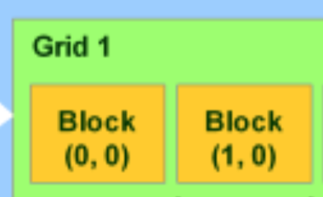
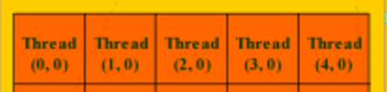
Exemplul 1
BlockIdx.x is the x number of the block
BlockDim.x is the total threads in x dimension (width)
If we launch vector_add<<<2, 4>>>
Primul thread (block(0), thread(0)): idx = 0 + 0 * 4 = 0
Threadul al 5-lea (block(1), thread(0)): idx = 0 + 1 * 4 = 4

Slide 33
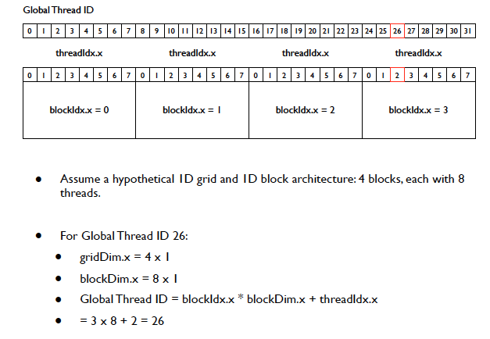
Exemplul 2

Slide 34
Block sizes
Architecture (Generation) | Code Name | SM Limit | Typical Recommended Block Size | Key Consideration
Volta, Turing, Ampere, Ada Lovelace (7.x, 7.5, 8.x, 8.9) | V100, RTX 20/30/40 Series | 1024 threads/SM | 128, 256, 512 | Optimized for latency hiding; prioritize shared memory and register usage.
Pascal (6.x) | GTX 10 Series, P100 | 1024 threads/SM | 128, 256, 512 | Similar to newer architectures, focus on resource balance.
Kepler, Maxwell (3.x, 5.x) | K40, GTX 7/9 Series | 1024 threads/SM | 256, 512 | Slightly higher preference for larger blocks to ensure full utilization.
Fermi (2.x) | GTX 4/5 Series | 1024 threads/SM | 128, 256 | Less flexible with resources; moderate size often best balance.

Slide 35
Memory Types
CUDA foloseste 5 tipuri de memorie fiecare cu proprietati diferite
Proprietati:
Size
Access speed
Read/write, read only

Slide 36
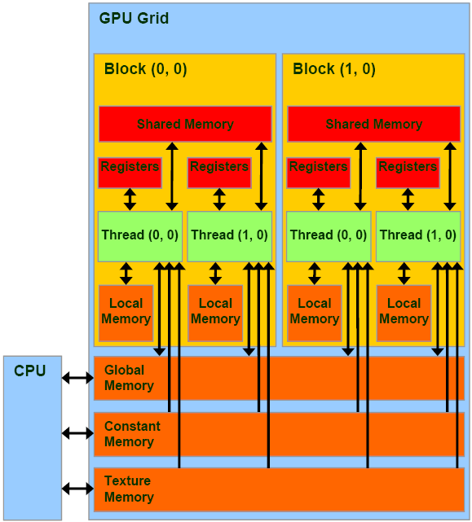

Slide 37
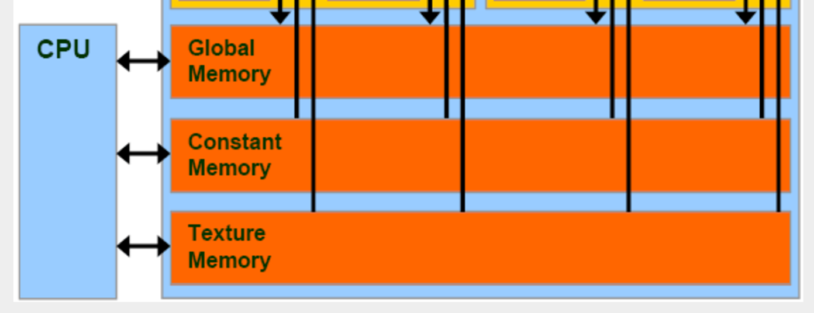
Memory Types
Global memory: cudaMalloc memory, the size is large, but slow
Texture memory: read only, cache optimized for 2D access pattern
Constant memory: slow but with cache (small)

Slide 38
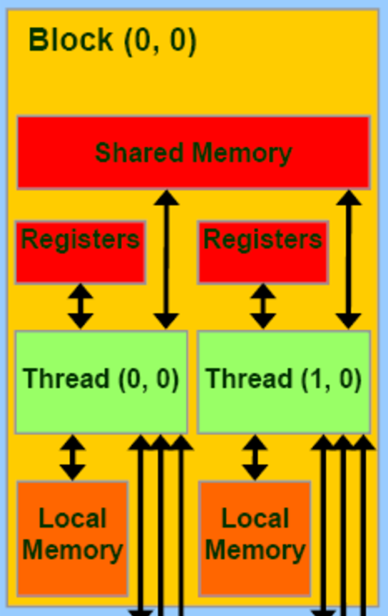
Memory Types
Local memory: local to thread, but it is as slow as global memory
Shared memory: 100x fast to global memory, it is accessible to all threads in one block

Slide 39
Memory Types
Shared memory is very fast, but usually only 64KB.
Actually, shared memory is the same as “L1 cache” of CPU, but controllable by user.
One block has one shared memory, that’s the reason why we manage the threads in grid and block way!

Slide 40
CUDA Memories characteristics

Slide 41
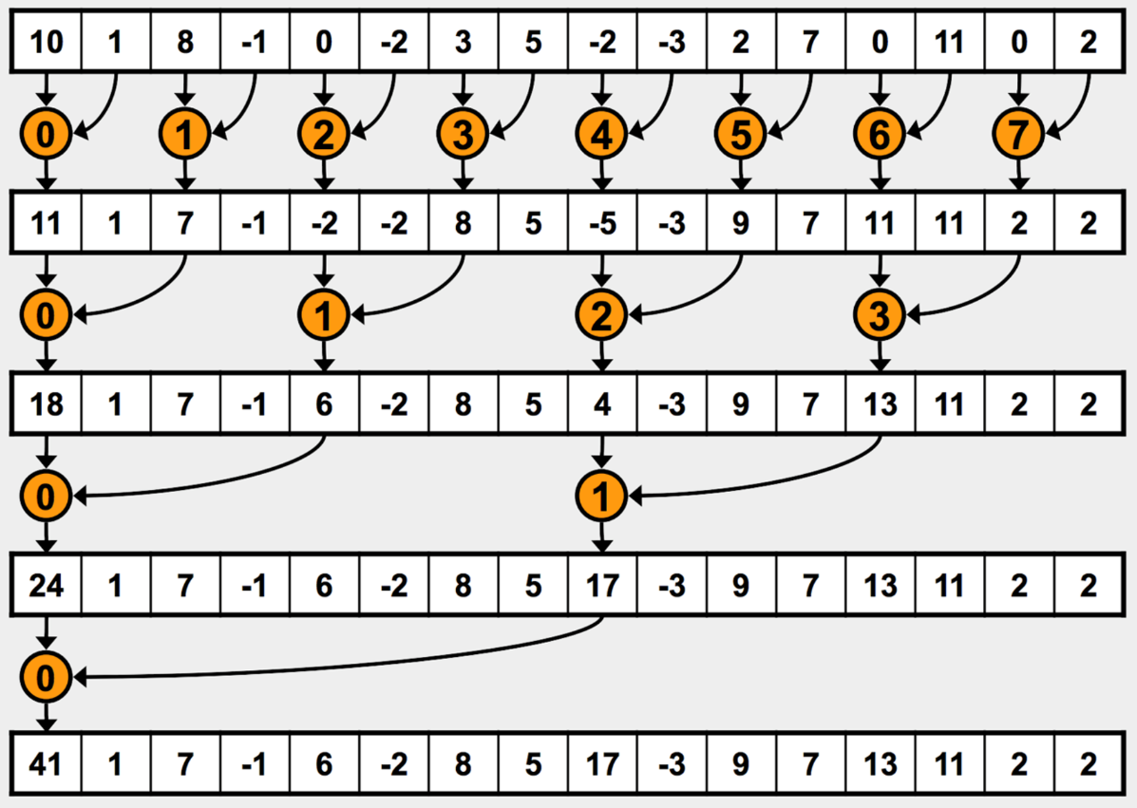
Exemplu: Reduction
!!! __syncthreads() is needed

Slide 42
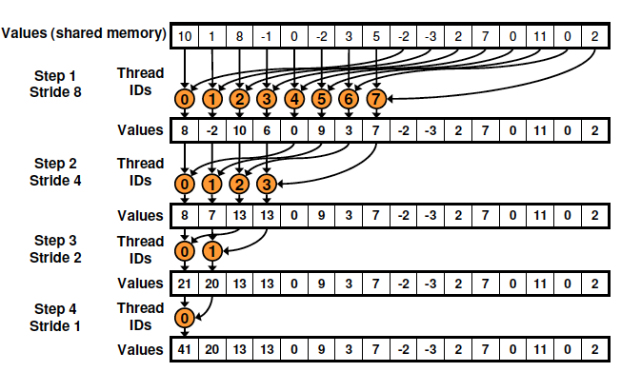
O alta varianta… dar similara (better for CUDA)

Slide 43
#define BLOCK_SIZE 512 // can be changed
#define NUM_OF_ELEMS 1024// can be changed
__global__ void total(float * input, float * output, int len) {
// Load a segment of the input vector into shared memory
__shared__ float partialSum[2*BLOCK_SIZE]; // no of elements allocated on shared memory
int globalThreadId = blockIdx.x*blockDim.x + threadIdx.x;
unsigned int t = threadIdx.x;
unsigned int start = 2*blockIdx.x*blockDim.x;
if ((start + t) < len) { partialSum[t] = input[start + t]; }
else { partialSum[t] = 0.0; }
if ((start + blockDim.x + t) < len) { partialSum[blockDim.x + t] = input[start + blockDim.x + t]; }
else { partialSum[blockDim.x + t] = 0.0; }
// Traverse reduction tree… (on each block)
for (unsigned int stride = blockDim.x; stride > 0; stride /= 2)
{
__syncthreads();
if (t < stride) partialSum[t] += partialSum[t + stride];
}
__syncthreads();
// Write the computed sum of the block to the output vector at correct index
if (t == 0 && (globalThreadId*2) < len)
{
output[blockIdx.x] = partialSum[t];
}
}

Slide 44
int main(int argc, char ** argv)
{
int ii;
float * hostInput; // The input 1D vector
float * hostOutput; // The output vector (partial sums)
float * deviceInput;
float * deviceOutput;
int numInputElements = NUM_OF_ELEMS; // number of elements in the input list
int numOutputElements; // number of elements in the output list
hostInput = (float *) malloc(sizeof(float) * numInputElements);
//initialization
for (int i=0; i < NUM_OF_ELEMS; i++) {
hostInput[i] = i; // set the input values
}
numOutputElements = numInputElements / (BLOCK_SIZE<<1);
if (numInputElements % (BLOCK_SIZE<<1)) { numOutputElements++; }
hostOutput = (float*) malloc(numOutputElements * sizeof(float));
//@Allocate GPU memory
cudaMalloc((void **)&deviceInput, numInputElements * sizeof(float));
cudaMalloc((void **)&deviceOutput, numOutputElements * sizeof(float));
// Copy memory to the GPU
cudaMemcpy(deviceInput, hostInput, numInputElements * sizeof(float), cudaMemcpyHostToDevice);

Slide 45
// Initialize the grid and block dimensions here
dim3 DimGrid( numOutputElements, 1, 1); //numOutputElements = no of blocks!
dim3 DimBlock(BLOCK_SIZE, 1, 1);
//each block compute a local sum - results are stored into deviceOutput[numOutputElements]
//********************************************************************
// Launch the GPU Kernel here
total<<<DimGrid, DimBlock>>>(deviceInput, deviceOutput, numInputElements);
//********************************************************************
// Copy the GPU memory back to the CPU here
cudaMemcpy(hostOutput, deviceOutput, numOutputElements * sizeof(float), cudaMemcpyDeviceToHost);
/ * Reduce output vector on the host*/
for (ii = 1; ii < numOutputElements; ii++) {
hostOutput[0] += hostOutput[ii];
}
printf("Reduced Sum from GPU = %f\n", hostOutput[0]);
// Free the GPU memory here
cudaFree(deviceInput);
cudaFree(deviceOutput);
free(hostInput);
free(hostOutput);
return 0;
}

Slide 46
Coordonare -> Host & Device
Kernel-urile sunt pornite asincron
Controlul este returnat catre CPU imediat
CPU necesita sincronizare inainte sa foloseasca rezultatele obtinute pe device
cudaMemcpy() blocheaza CPU pana cand copierea se finalizeaza.
Copierea incepe atunci cand toate apelurile CUDA anterioare s-au terminat;
cudaMemcpyAsync() asynchronous -> nu blocheaza CPU
cudaDeviceSynchronize() blocheaza CPU pana toate apelurile CUDA se finalizeaza.

Slide 47
NVIDIA GPU Execution Model
I. SIMD Execution of warpsize=M threads (from single block)
II. Multithreaded Execution across different instruction streams within block
Also, possibly across different blocks if there are more blocks than SMs
III. Each block mapped to single SM
No direct interaction across SMs
Device
Multiprocessor N
Multiprocessor 2
Multiprocessor 1
Data Cache: Fermi, Kepler
Shared Memory
Registers
Registers
Registers
Instruction
Unit
Processor 1
Processor 2
…
Processor M
Constant
Cache
Texture
Cache
Device memory

Slide 48
SIMT = Single-Instruction Multiple Threads
Model introdus de catre Nvidia
Combina executia de tip
SIMD din interiorul unui Block (pe un SM) cu executia
SPMD intre Block-uri (distribuita pe /across SMs)

Slide 49
Organizare - Structurare
In GPU, unitatea de procesare este SP (streaming processor);
Mai multe SP si alte componente formeaza un SM (streaming multiprocessor);
Mai multe SM formeaza un TPC (texture processing cluster)
In CUDA, putem spune ca
un grid este procesat de catre intreg device-ul GPU,
un block este procesat de catre un SM, and
un thread este procesat de catre un SP.

Slide 50
WRAP
fiecare SM are 8 SP si pot fi 4 instructiuni in executie – pipelined => 32 threads
Cate 32 threads compun un wrap.
Daca se alege un numar de threaduri care nu se divide cu 32 atunci restul va forma un wrap (-> ineficient)
De fiecare data un SM proceseaza doar un wrap si astfel ca daca sunt mai putin de 32 threads intr-un wrap atunci unele SP nu sunt folosite.
The warp size is the number of threads running concurrently on an SM.
De fapt threadurile ruleaza si in paralel dar si pipelined
fiecare SM contine cate 8 SP
cea mai rapida instructiune necesita 4 cicluri (cycles).
=> fiecare SP poate avea 4 instructiuni in propriul pipeline, deci avem un total de 8 × 4 = 32 instructiuni care se executa concurent.
In interiorul unui warp, thread-urile au indecsi secventiali:
Primul 0..31, urmatorul 32..63 s.a.md. Pana la numarul total de threaduri dintr-un block.[http://cuda-programming.blogspot.ro/2013/01/what-is-warp-in-cuda.html]

Slide 51
Efect-> wrap
Omogenitatea threadurilor dintr-un wrap are un efect important asupra performantei calculului (computational throughput).
Daca toate threadurile executa aceeasi instructiune atunci toate SP dintr-un SM pot executa aceeasi instructiune in paralel.
Daca un thread dintr-un presupus wrap executa o instructiune diferita de celelalte, atunci acel wrap trebuie sa fie partitionat in grupuri de threaduri bazat pe instructiunile care urmeaza sa fie executate; apoi grupurile se executa unul dupa altul.
Aceasta serializare reduce ‘throughput-ul’
pe masura ce threadurile devin tot mai heterogene se impart in grupuri tot mai mici.
Rezulta ca este important sa se pastreze omogenitatatea pe cat posibil!

Slide 52
Threads in Blocks
Atunci cand un thread asteapta date, unitatea SM va alege un alt thread pentru a fi executat – astfel se ascunde latenta de acces la memorie.
Astfel definirea a mai multe threaduri dintr-un block pot ascunde mai mult latenta;
Dar mai multe thread-uri intr-un block inseamna ca memoria partajata per threaduri este mai mica.
Recomandarea NVIDIA: un block necesita cel putin 192 threaduri pentru a ascunde latenta corespunzatoare accesului la memorie.

Slide 53
Optimizare
Evitarea copiilor/transferurilor dintre memoriile CPU si GPU
Folosire shared memory – acces rapid
Alegerea potrivita a numarului de blocuri
Array alignment ( alignment at 64 byte boundary)
Continuous memory access
Folosirea functiilor din CUDA API

Slide 54
Floating Point Operations
Results of floating-point computations will slightly differ because of:
Different compiler outputs, instruction sets
Use of extended precision for intermediate results
There are various options to force strict single precision on the host

Slide 55
Synchronization
Using Cooperative Groups (Since Volta - Architecture 7.0+)
Cooperative Groups introduced a powerful way to organize threads beyond the traditional block/grid structure, supporting explicit synchronization across a user-defined group of threads.
Cooperative Launch: Allows launching grids where all blocks run simultaneously.
cooperative_groups::grid_group: This group type allows all blocks in the cooperatively launched grid to synchronize with each other using the group.sync() command.
Constraint: This feature is limited by hardware and driver constraints, typically only supporting a specific number of blocks per launch, depending on the GPU architecture. It is mainly used for fine-grained parallel algorithms that cannot be easily broken into two separate kernels.

Slide 56
COMPILARE
EXECUTIE

Slide 57
Compiling a CUDA Program
Parallel Thread eXecution (PTX)‏
Virtual Machine and ISA
Programming model
Execution resources and state
C/C++ CUDA
Application
float me = gx[gtid];
me.x += me.y * me.z;
NVCC
CPU Code
Virtual
PTX Code
Physical
PTX to Target
Compiler
ld.global.v4.f32 {$f1,$f3,$f5,$f7}, [$r9+0];
mad.f32 $f1, $f5, $f3, $f1;
G80
…
GPU
Target code

Slide 58
Compilation
Any source file containing CUDA language extensions must be compiled with NVCC
NVCC is a compiler driver
Works by invoking all the necessary tools and compilers like cudacc, g++, cl, ...
NVCC outputs:
C code (host CPU Code)
Must then be compiled with the rest of the application using another tool
PTX
Object code directly
Or, PTX source, interpreted at runtime

Slide 59
Referinte prezentare
Prezentarea este bazata pe slide-uri din urmatoarele referinte:
David Kirk/NVIDIA and Wen-mei W. Hwu, 2007-2010. ECE 498AL, University of Illinois, Urbana-Champaign
http://cuda-programming.blogspot.ro/2013/01/what-is-constant-memory-in-cuda.html
Li Sung-Chi. Taiwan Evolutionary Intelligence Laboratory. 2016/12/14 Group Meeting Presentation
Cyril Zeller. CUDA C/C++ Basics. Supercomputing 2011 Tutorial, NVIDIA Corporation http://www.nvidia.com/docs/io/116711/sc11-cuda-c-basics.pdf

